Slide 1
Topic: Bivariate data
EQ: what is Bivariate data, and how can it be useful for statistical analysis?

Slide 2
Review of Data types
There are 2 sub-categories of data- Numerical and Categorical
Numerical data is data relating to numbers
Categorical is data based on observable characteristics.
Univariate data is single piece data – height, weight, shoe size
Bivariate data is two-piece data – heigh and weight, Heartbeat and exercise amount, Reaction times and Sleep amount ect.
Bivariate data is often represented in a table

Slide 3
Bivariate data
EQ: What is bivariate data, and how can it be useful for statistical analysis?
An example of bivariate data that you may encounter is the “value of drinks sold at the school canteen” and the “daily temperature”
Daily Temperature (Cº) | Drinks sold
18 | 160
22 | 200
24 | 250
33 | 450
30 | 430
28 | 300
29 | 360
17 | 150
23 | 230
27 | 250
Does it look like the number of drinks sold is affected by the temperature?

Slide 4
Bivariate data
EQ: What is bivariate data, and how can it be useful for statistical analysis?
This chart is called a scatterplot. It is used with bivariate data to determine if there is a trend in out data or not.
As the daily temperature (x-axis) increases, does the amount of drinks sold increase (y-axis)?

Slide 5
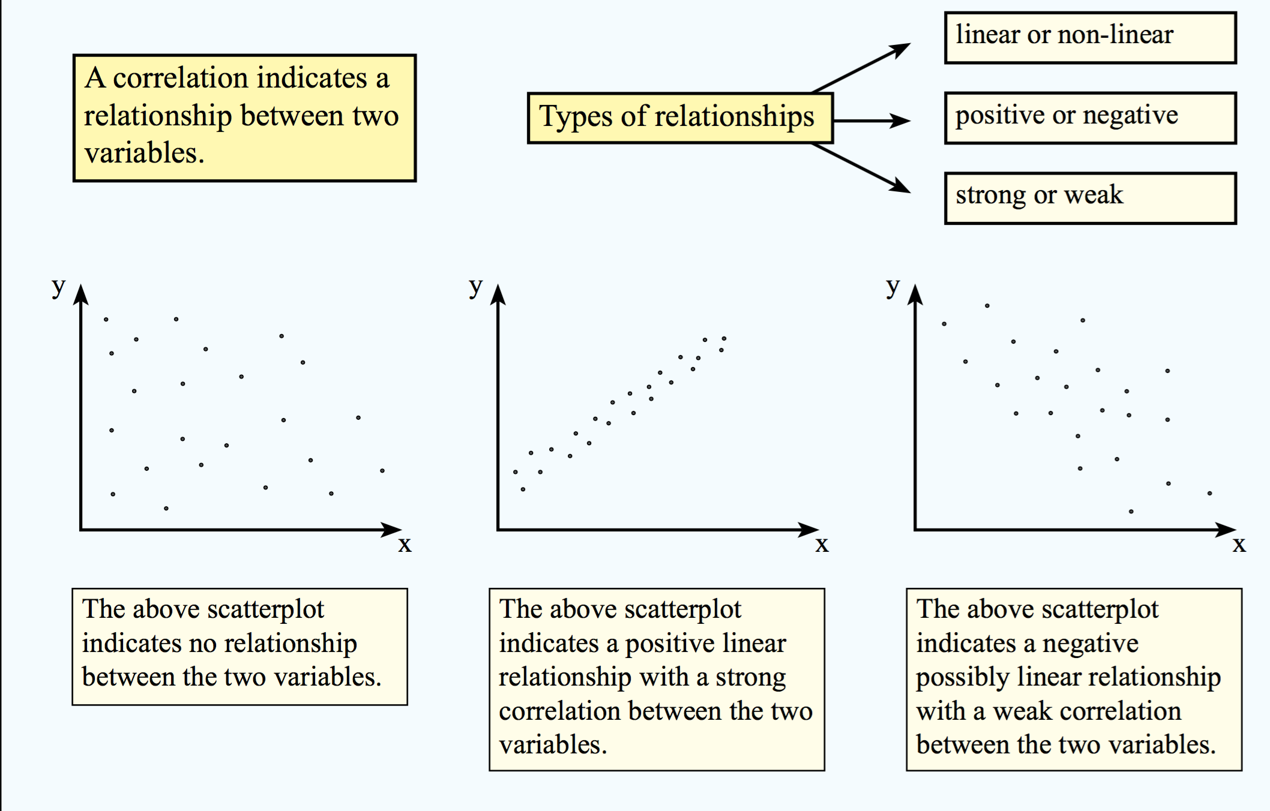
Bivariate data
EQ: What is bivariate data, and how can it be useful for statistical analysis?
When constructing scatterplots of bivariate data, we often describe the correlation and trend of the data. Some of the key words are listed below.

Slide 6
Bivariate data
EQ: What is bivariate data, and how can it be useful for statistical analysis?
How would you describe this scatterplot?
Strong or Weak?
Linear or Not?
Positive or Negative?
Our graph is a strong, positive graph, that is almost linear.

Slide 7
Your turn
Sam’s Mum wants to buy a new Golf. She looks on gumtree and makes a list of how many years old the car is, and the sale price.
Cost of car ($) | Number of years old
32000 | 0
29500 | 1
24500 | 2
20,000 | 3
16500 | 5
14500 | 6
13000 | 7
10900 | 8
10500 | 9
7500 | 11
Which variable is the;
Independent
- Number of years old
Dependent
- Cost of the car
Make a scatterplot of the data, and describe the trend

Slide 8
Car data Scatter plot
We can see that the lower the years on the car, the more expensive it is to buy.
The trend is very linear, and negative. The dots form almost a straight line, so the correlation could be classified as strong.

